Slide 1

Modern Analytics Academy “Vignettes”
Follow up to Modern Analytics Academy: https://aka.ms/maa
Topical sessions that addresses:
New features and how to use them
Frequent questions we receive
Updates to a previous session
Cameron Kahrs
Cloud Solution Architect

Slide 2
Modern Analytics Academy “Vignettes”
Power BI Deployment Pipelines
https://aka.ms/maa
Cameron Kahrs
Cloud Solution Architect

Slide 3





Academy Sessions
Acquisition & Storage
Modeling
Pipelines
Security & Governance
Visualization
Azure Data Lake
Azure Cosmos DB
Azure Event Hubs
Synapse Link
Data Lake Structure
Synapse Spark Pools
Synapse SQL Pools
Synapse Serverless SQL
Azure Data Factory
Synapse Pipelines
Power BI Dataflows
Azure Stream Analytics
Auditing
Security
Azure Purview
Power BI
Paginated Reports
Power BI Embedded

Slide 4
Agenda
Overview
Use Cases
Demo
How to Automate
Best Practices
Power BI Deployment Pipelines

Slide 5
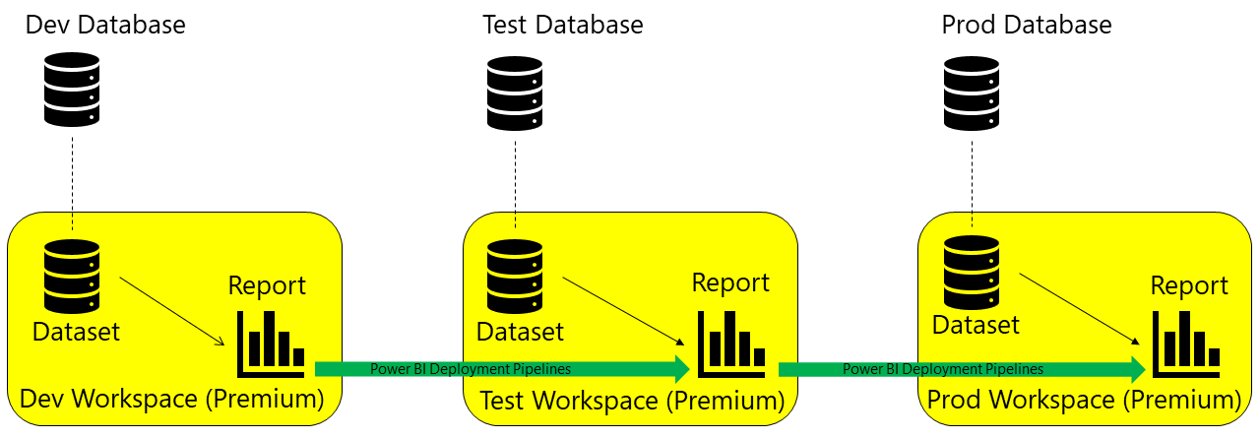
Power BI Deployment Pipelines Overview

Slide 6
Agenda
Overview
Use Cases
Demo
How to Automate
Best Practices
Power BI Deployment Pipelines

Slide 7
Use Cases for Power BI Deployment Pipelines
Reduce load on Prod environment (especially if using Direct Query)
Development database isn’t overloaded with entire volume of production data
Control over permissions between environments
Has the ability to be automated via APIs or Azure Dev Ops

Slide 8
Agenda
Overview
Use Cases
Demo
How to Automate
Best Practices
Power BI Deployment Pipelines

Slide 9
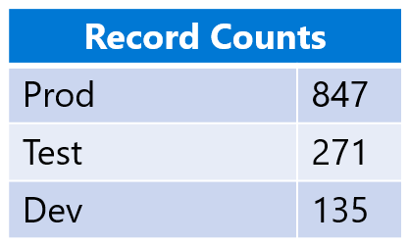
Demo
Three Azure SQL Databases with the Sample Database loaded
Each database has a different number of records in the ‘SalesLT.Customer’ table.
Each workspace will point to a different database using Power BI Deployment Pipelines; dev, test, prod.
Power BI report will have one visual, a record count of customer. This will make it easy to see that the connections are different.

Slide 10
Agenda
Overview
Use Cases
Demo
How to Automate
Best Practices
Power BI Deployment Pipelines

Slide 11
Automating Power BI Deployment Pipelines Rest API
Get pipeline information
Get pipeline content, deployment status and deployment history
Deploy
Create and delete pipelines
Manage workspaces
Assign/unassign workspaces to pipelines
Manage pipeline users

Slide 12
Automating Power BI Deployment Pipelines Azure DevOps Pipeline
PowerShell
Power BI Automation Tools
Open-source Azure DevOps extension
Service Principal is recommended
Deployment Pipeline Tasks
Create a new pipeline
Assign a workspace to a pipeline stage
Add a user to a deployment pipeline
Add a user to a workspace
Deploy content to a deployment pipeline
Remove a workspace from a deployment pipeline
Delete a pipeline

Slide 13
Agenda
Overview
Use Cases
Demo
How to Automate
Best Practices
Power BI Deployment Pipelines

Slide 14
Best Practices for Power BI Deployment Pipelines Content Preparation
Treat each workspace as a complete package of analytics
Plan your permission model
Connect different stages to different databases
Notes:
Ideally, a workspace should contain a complete view of one aspect (such as department, business unit, project, or vertical) in your organization. This makes it easier to manage permissions for different users, and allows content releases for the entire workspace to be controlled according to a planned schedule.
A deployment pipeline is a Power BI object, with its own permissions. In addition, the pipeline contains workspaces, that have their own permissions.
To implement a secure and easy workflow, plan who gets access to each part of the pipeline. Some of the considerations to take into account are:
Who should have access to the pipeline?
Which operations should users with pipeline access be able to perform in each stage?
Who's reviewing content in the test stage?

Slide 15
Best Practices for Power BI Deployment Pipelines Content Preparation
Use parameters in your model where you can’t use Power BI Deployment Pipelines
Supported data sources for Power BI Deployment Pipelines (as of 5/2/22):
Azure Analysis Services
Azure Synapse
SQL Server Analysis Services (SSAS)
Azure SQL Server
SQL server
Odata Feed
Oracle
SapHana (only supported for import mode; not direct query mode)
SharePoint
Teradata
Notes:
Ideally, a workspace should contain a complete view of one aspect (such as department, business unit, project, or vertical) in your organization. This makes it easier to manage permissions for different users, and allows content releases for the entire workspace to be controlled according to a planned schedule.
A deployment pipeline is a Power BI object, with its own permissions. In addition, the pipeline contains workspaces, that have their own permissions.
To implement a secure and easy workflow, plan who gets access to each part of the pipeline. Some of the considerations to take into account are:
Who should have access to the pipeline?
Which operations should users with pipeline access be able to perform in each stage?
Who's reviewing content in the test stage?

Slide 16
Best Practices for Power BI Deployment Pipelines Development
Use Power BI desktop to edit your reports and datasets
Version control for PBIX files
Separate modeling development from report and dashboard development

Slide 17
Best Practices for Power BI Deployment Pipelines Test
Simulate your production environment
Measure Performance
Test your app

Slide 18
Best Practices for Power BI Deployment Pipelines Production
Manage who can deploy to production
Update the production app
Quick fixes to content, go through the whole pipeline

Slide 19
Thank you!
Modern Analytics Academy “Vignettes”
Power BI Deployment Pipelines
https://aka.ms/maa

Slide 20


Dev Database
Test Database
Prod Database
Report
Report
Report
Dataset
Dataset
Dataset
Power BI Deployment Pipelines
Power BI Deployment Pipelines
Dev Workspace (Premium)
Test Workspace (Premium)
Prod Workspace (Premium)

Slide 21




Power BI Service
Premium Capacity
Dev
Dev Workspace
Test
Deployment Pipelines
Publish App
Test Workspaces
Test App
Prod
Deployment Pipelines
Publish App
Prod Workspaces
Prod App
Power BI Deployment Pipelines

Slide 22
Record Counts
Prod | 847
Test | 271
Dev | 135

